Slide 1
How To Make Your Major Gifts Program Successful
This presentation, in whole or in part, may be used for non-commercial purposes with attribution to Veritus Group. It may NOT be used, in whole or in part, for commercial purposes unless written permission from Veritus Group has been given.

Slide 2
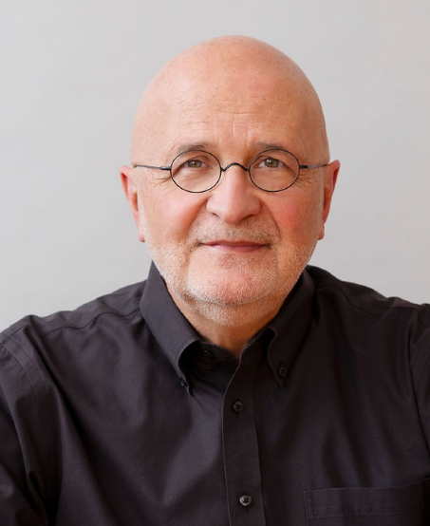
Presented by:
Richard Perry Founding Partner Veritus Group

Slide 3
Session Agenda

Slide 4
OBJECTIVE

Slide 5

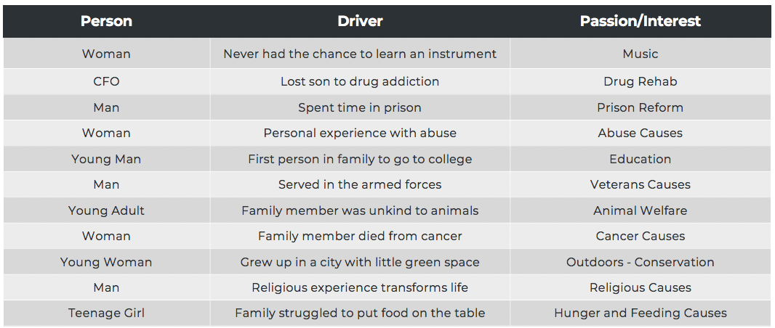
Passion and Interest Drivers
Notes:
Go through the stories. Learn what is behind why a donor supports a particular cause or program. This will help you bring the donor to the scene of the need.
THEN….ask them:
What are the drivers behind YOUR passions and interests?
What are the drivers behind your donor’s passions and interests?
DISCUSSION

Slide 6
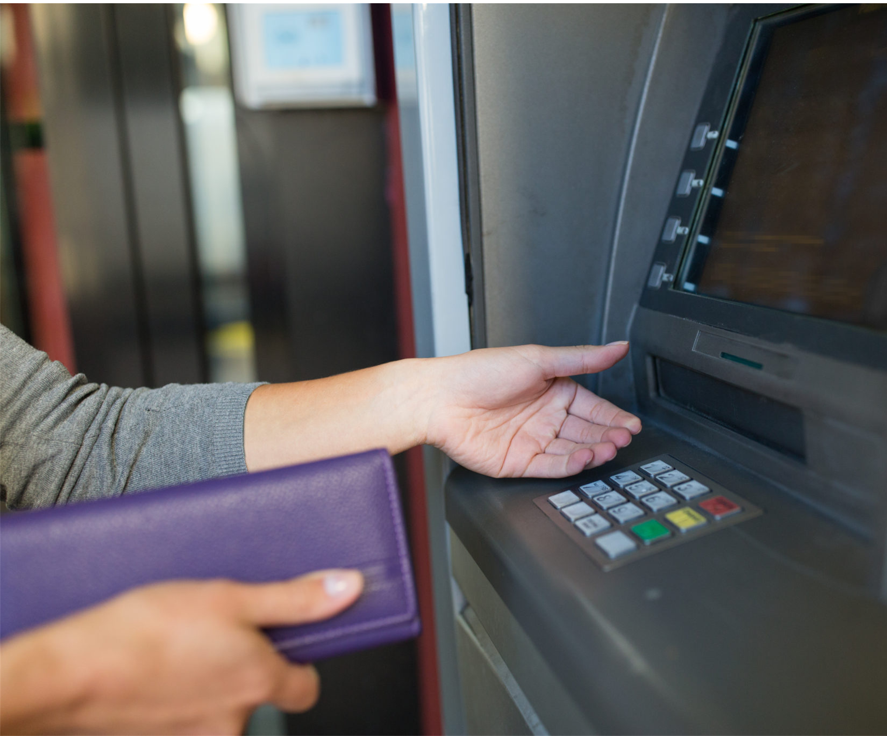
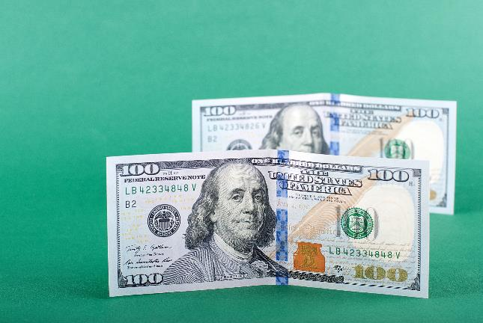

Three Operating Principles
1
2
3
Treat donors as partners not sources of cash
Money transfers value: Money is a result not an objective
Donors have life. Treated properly they will give frequently and last a lifetime

Slide 7

The Problem And The Opportunity

Slide 8
Problem
!
The Difference Between…
Donor Attrition
Donor Value Attrition

Slide 9

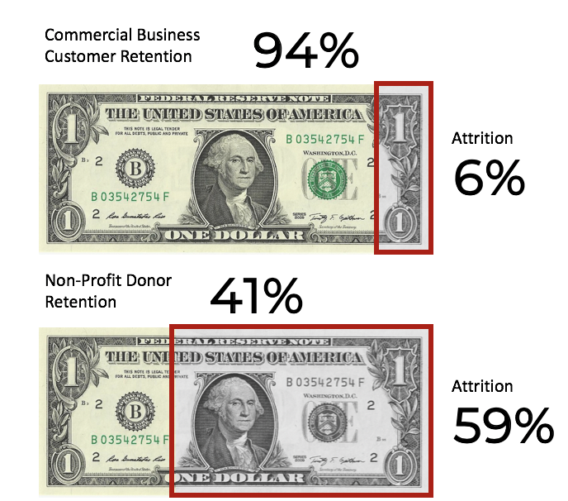
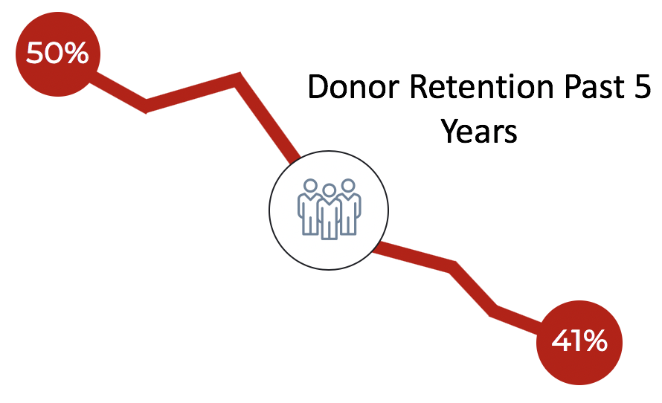
THINGS ARE NOT GOING WELL
Non-profit Donor Retention
Veritus Group

Slide 10
No
Type
ID
Zip
Year 1
Year 2
Year 3
1
1
xxxxxx
zzzzz
$100,000
$100,000
2
1
xxxxxx
zzzzz
$75,600
$20,500
$35,550
3
1
xxxxxx
zzzzz
$72,000
4
1
xxxxxx
zzzzz
$62,859
5
1
xxxxxx
zzzzz
$50,000
$25,000
6
1
xxxxxx
zzzzz
$44,084
$11,978
$13,000
7
1
xxxxxx
zzzzz
$42,270
$8,675
784
1
xxxxxx
zzzzz
$5,000
785
1
xxxxxx
zzzzz
$5,000
786 donors give
$8 million in one year and only $4.6 million
the next year.
786
1
xxxxxx
zzzzz
$5,000
787
1
xxxxxx
zzzzz
$5,000
786
1
xxxxxx
zzzzz
$5,000
Totals
$8,025,927
$4,659,444
$4,241,938
-41.95%
-8.96%
Veritus Group

Slide 11
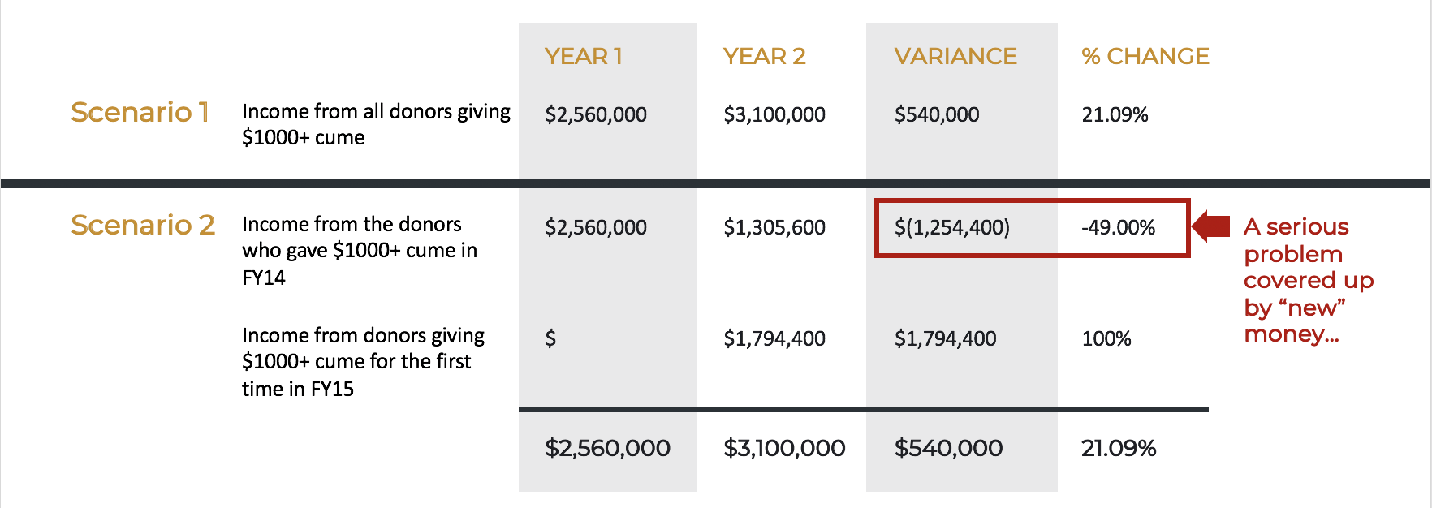
NEW MONEY HIDES LOSSES
Veritus Group

Slide 12
What Could Be
Going Wrong? And What Do You Need To Do?

Slide 13
Very simply put…This is how we lose our donors.
…so I gave somewhere else to make a difference.
You didn’t tell me my gift made a difference...
You asked me to help. Said it would make a difference.
So I want to help again.
You made me aware.
I believed you. Gave what I could.
You told me my gift made a difference.

Slide 14
Create A
Good Caseload

Slide 15

VERITUS
Caseload donors are unqualified, so MGOs are wasting time trying to get ahold of donors who are not interested.

Slide 16
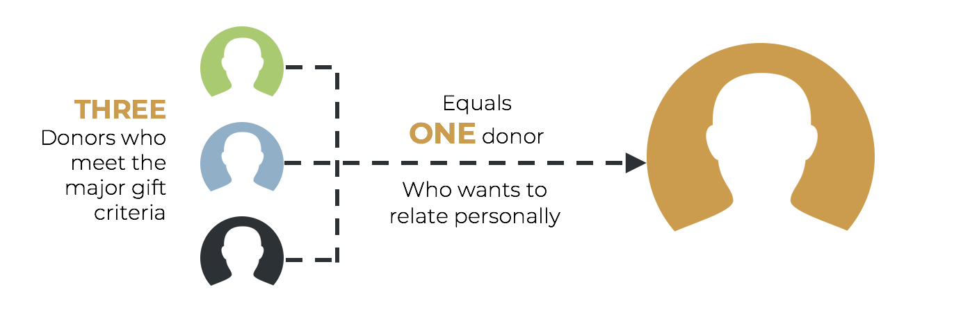
Only ONE in Three Wants To Relate
Veritus Group

Slide 17
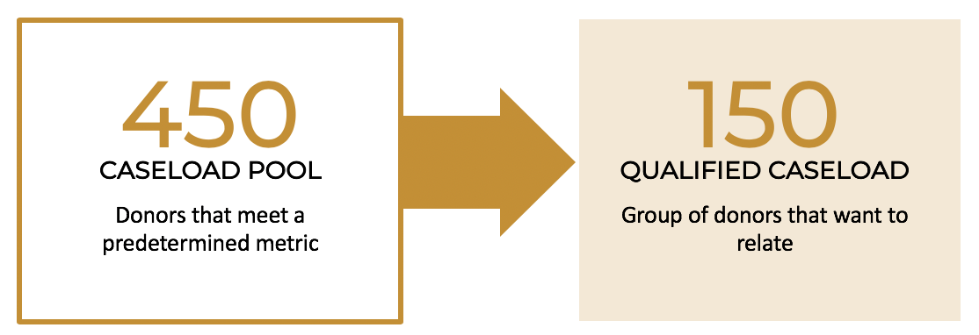
Right CASELOAD
How Creating a Caseload Should Work:
Veritus Group

Slide 18

What To Think About First
Focus On
Current Donors

Slide 19
Have a Personalized Goal For Every Donor

Slide 20
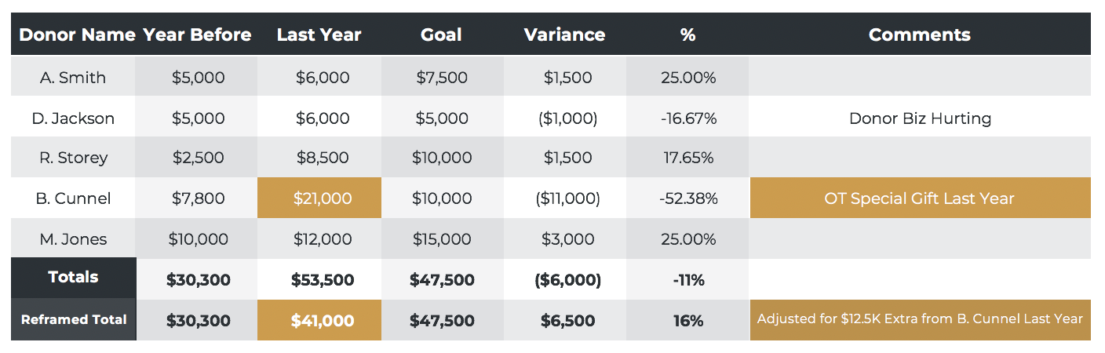
Set Individual Goals
Veritus Group

Slide 21
Create A Clear Plan
For Every Donor
Notes:
Too many donors to manage without a clear plan and goal for each can feel like this

Slide 22
Tiering Donors
Caseload Mix
LEVEL OF DONORS
Count
% Effort
Strategy/Messaging
Outcomes
A
Very Personal
Strategic Moves
• 6 and 7 Figure Gifts • Retention • Repeat Giving
A
10
50%
B
• Major Upgrading • Retention • Repeat Giving
B
40
30%
C
C
100
20%
• Smaller Upgrading • Retention • Repeat Giving
Less Personal
Tactical Moves
Top Tier High Capacity Donors
Medium Capacity Donors
Average Capacity Donors
Notes:
Why do we tier?
Be aware of your ROI
The A donor This is your top tier, high capacity, high inclination donor. They contribute above average gifts and make up almost half of the dollar value of your caseload. We think this group should be the smallest group of donors on your caseload, somewhere between 10-15% and contribute almost half of the total caseload value.
The B donor
This group of donors represent the medium contribution of your caseload. In the example above, they are the $5,000 giver. There are more of them – 40-50% – and they contribute over a third of the caseload value.
The C donor
This group of donors are the low end of your caseload, contributing the lowest average amounts.
Type
Contact information – up to you, depends a lot on your data system, and yoru personal working preference

Slide 23
Moves Management
Identify Interests And Passions: Build Relationships
TOUCHPOINT
YMAD
YMAD
GIFT
IDENTIFY PROBLEMS
TOUCHPOINT
TOUCHPOINT
YMAD
ASK
INVITATION TO CONSIDER ADDRESSING THE PROBLEM

Slide 24
Creating a Plan for Every Donor
Paul Smith GOAL: $25,000 Interest/Passion: Disaster Services Comm Preference: E-Mail
Betty Richards GOAL: $50,000 Interest/Passion: Single Mothers Comm Preference: Personal Visits
JAN
FEB
MAR
APR
MAY
JUN
JUL
AUG
SEPT
OCT
NOV
DEC
Paul
Smith
YMAD touch
Email Internal Memo
Email to invite to EDS Briefing
YMAD+ person helped letter
Birthday Card
Visit program site – opp briefing
YMAD plus ASK
YMAD touch and thanks
Ride along in EDS vehicle for demo
YMAD with possible special ASK
Send report back on EDS program
YMAD – Book on the Poor
JAN
FEB
MAR
APR
MAY
JUN
JUL
AUG
SEPT
OCT
NOV
DEC
Betty Richards
Send program update from 2018 gift
Tour House of Hope – meet Sally/Kid
Internal doc on expansion plans + YMAD
Invite to architect briefing + dinner
Visit in home present final plan and ASK
Thanks and YMAD
Invite to “Founders luncheon”
Research on plight of single moms
Birthday card and YMAD
Ground breaking ceremony, visit with new mom
YMAD with possible special ASK
YMAD and gift of H of H child drawing
Veritus Group

Slide 25

Create Compelling
Donor Offers

Slide 26

Definition
A donor offer is a compelling and persuasive story for support.

Slide 27



Elements of a compelling offer.
Compelling Need
Believable Solution
Donor Adoption
+
=

Slide 28

Move Away From Transaction Based Asks

Slide 29


Preparing to Ask
Qualification
Know the donor
Report back
Passions and interests
Share stories
Know your programs
Gain Confidence
Practice!
Get your ego out of the way
Be present
Understand different personalities

Slide 30
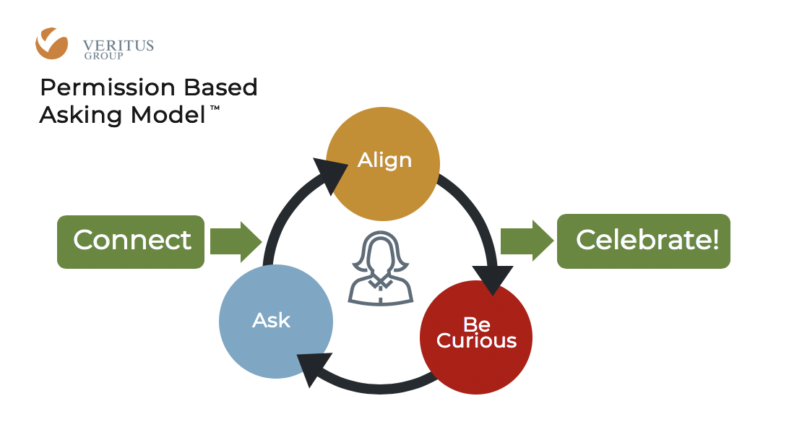
Overview

Slide 31
Thank
Donors Properly
Notes:
A receipt is expected. We need to do the unexpected.
Should not be neglected or delayed.
Thanks yous must be prompt, personal, persistent.
Have your thank you system in place. VP calls or does note.
Have a system in place for thanking donors. In particular, large donations. Have a system of how you will respond and who will respond before a gift is received.
APL/SPCA Example

Slide 32

Report Back

Slide 33
Understand The Economics Of Major Gifts

Slide 34

Keeping Perspective On What It’s About
A Caseload Has A Dual Purpose
Fulfill Donor Passions and Interests
Secure Funds For Program
Veritus Group

Slide 35
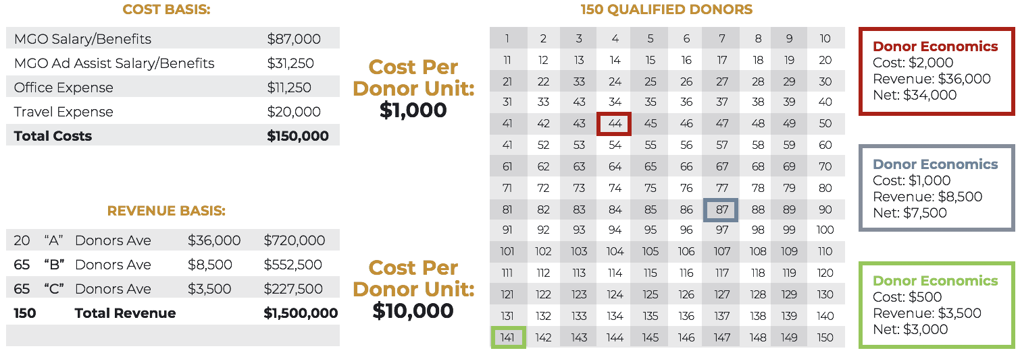
MANAGEMENT
An Economic Destination
Veritus Group

Slide 36
HOW A CASELOAD GROWS
Caseload Value Will Grow Over Time
YEAR 4
YEAR 3
$1,500,000
YEAR 2
$1,100,000
120 Donors
YEAR 1
$1,000,000
125 Donors
$125,000
10 Donors
$800,000
135 Donors
$100,000
12 Donors
$110,000
10 Donors
150 Donors
$75,000
15 Donors
$90,000
13 Donors
$85,000
10 Donors
TOTALS
$800,000
$1,075,000
$1,290,000
$1,820,000
Quality of caseload increases over time | Value and donor attrition decreases over time
Veritus Group

Slide 37
Major Gifts Return on Investment
Reasonable Returns on Investment Over the Major Gifts Program Lifecycle
1:6 or 1:10
1:3 or 1:8
1:2 or 1:3
New Program
Moving Toward
Mature
Veritus Group
Notes:
NEED SHORTER TITLES/COPY

Slide 38
Measure The Right Things

Slide 39
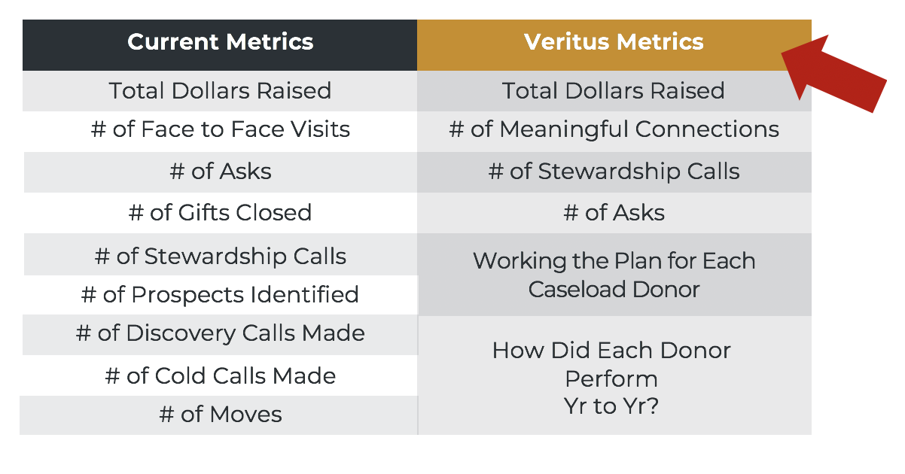
Key Performance Metrics and Reports
What Do We Measure?
Veritus Group

Slide 40


Questions

Slide 41
VeritusGroup.com
facebook.com/VeritusGroup
@VeritusGroup
VeritusGroup.com/passionate-giving-blog
Richard Perry
Email: rperry@veritusgroup.com
Veritus Group
Notes:
Standard formatting for all Veritus PPTs

