Slide 1
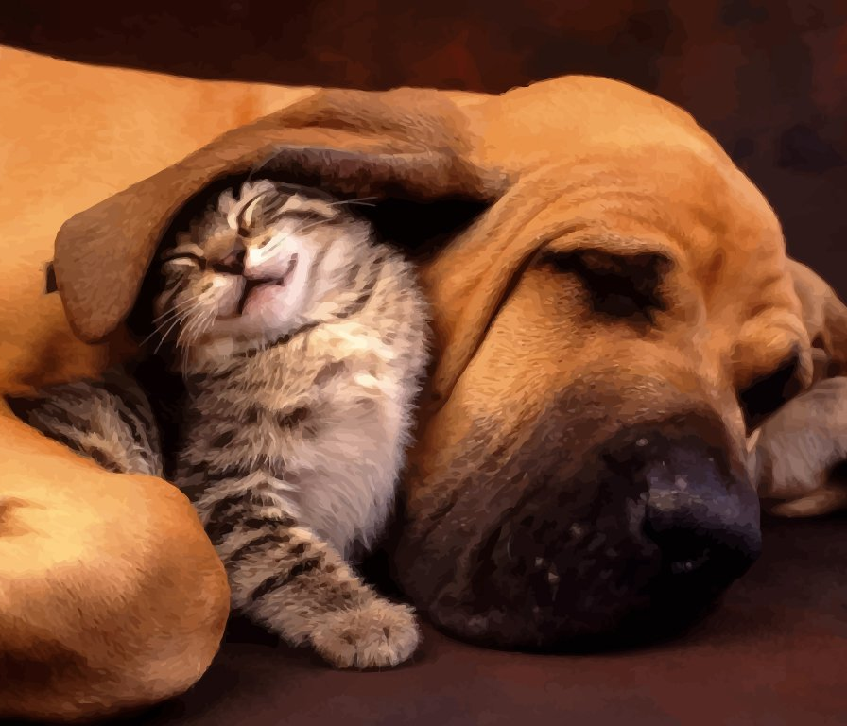
Donor-Centric Relationships
Communication, Authenticity and Trust
Loretta Shelton
Executive Director,
Four Seasons Foundation

Slide 2
Four Seasons Foundation - 2016
Wonderful 40 year old organization
Event-driven fundraising
Bequests
United Way
No annual fund program
No major gifts program
Notes:
Starting from scratch.

Slide 3
Major in the Majors

Slide 4
Your Major Gift Donors
Nationally - 2017
Your Donors
$410 Billion
Up 5%
1000 donors
Top 120 +/-
44% of nonprofits consider gifts of $1000 as major gifts
Notes:
Giving increased to all types of charities - religion, education, human services, health, social causes, art and culture, international affairs, environment, and animals.

Slide 5
Major Gift Programs
Focus:
Wallet

Slide 6
What’s in Your Heart?

Slide 7
Intimacy
Communication
Authenticity
Trust

Slide 8
Donor-Centric Relationships
Discovery
Cultivation
Solicitation
Stewardship
Notes:
Donor’s heart.

Slide 9
Donor-Centric Discovery
Mission Credibility
Organizational Credibility
Professional & Personal Credibility
Communication
Authenticity
Trust

Slide 10
Professional and
Personal Credibility
Not what’s in their wallet, but what’s in my heart?
Love and Appreciation
Curiosity and Interest
Authenticity and Connection

Slide 11
Donor-Centric Cultivation
Self-Check
Organizational Needs vs. Community Needs
Donor’s Philanthropic Interest
Communication
Authenticity
Trust

Slide 12
Donor’s Philanthropic Interest
Not what’s in their wallet, but what’s in their heart?
Where is the intersection of their heart and your mission?
Engage, ask questions, and listen.

Slide 13
Fear of Asking
Intimacy
NOT Intimidation
Closeness with another person, like the intimacy that develops between friends as you tell one another your life stories and dreams for the future.
From the Latin word intimare, which means “make familiar,” which comes from the Latin intimus, meaning “inmost.” Intimacy is a close, family-like connection.
the feeling of being intimidated; being made to feel afraid or timid
Type of fear, fearfulness, fright
an emotion experienced in anticipation of danger (usually accompanied by a desire to flee or fight)
discouragement in the face of someone's superior fame or wealth or status etc.
Type of discouragement, disheartenment, dismay or the feeling of despair in the face of obstacles

Slide 14
Donor-Centric Solicitation
People Want to Make a Difference
Understand the Need
Inner Satisfaction from Giving
Communication
Authenticity
Trust

Slide 15
Inner Satisfaction from Giving
Giving as an Expression of Donor’s:
Spiritual Meaning
Selflessness
Community Leadership
Family Legacy
Personal Achievement

Slide 16
Questions?
Thank you!

