Slide 1
Six Great Ideas for Helping Donors Plan
Their Most Significant Gifts
Sheryl Aikman
Alenda Consulting
February 2021

Slide 2
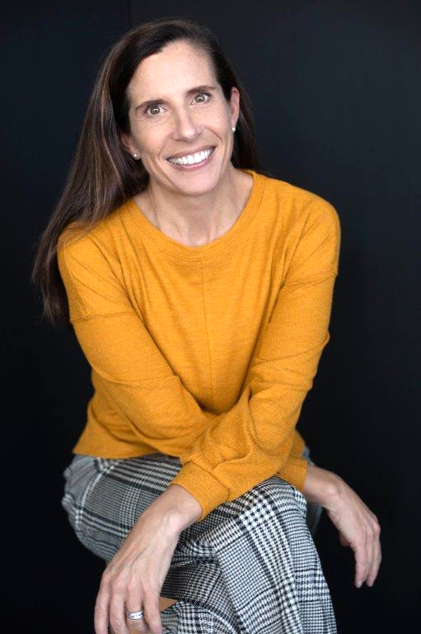
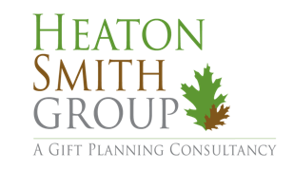
Alenda Consulting
Philanthropic and Charitable Gift Counsel
~ Expert guide for individuals and families navigating questions about donor advised funds, family philanthropy, and legacy planning.
~ Trusted partner for professional advisors who want to add value with custom counsel for charitably-minded clients.
~ Targeted support for nonprofits seeking to establish, amplify or enhance their planned giving program.
~ Leadership for community foundations to grow asset development, gift planning, endowed giving, donor relations, advisor outreach and nonprofit fund relationships.
Let’s talk about what you need and how I can help.
alendaconsulting@gmail.com
828.231.0721
Also proudly affiliated with:

Slide 3
Donors
Notes:
From Giving USA:
The average donor writes their first will at age 44.
53% of donors set up their first legacy gift at writing their first will.
The average age at which donors made their first planned gift was 52.8 years old.
68% of donors make their legacy gift via a charitable bequest.
Close to 30% of donors make their legacy gift by naming the charity as a beneficiary of their retirement plan.
A planned gift simply means the donor thinks about it; it’s not made on impulse (It is outright or deferred).
A deferred gift simply means the donor doesn’t give it to you today (It’s not outright, but comes to you after a specified term of years or after the donor dies).
A legacy gift simply means the donor makes the gift with an eye towards perpetuating their values after they’re gone (it is outright, and set up to leave a future income stream via an endowment or donor advised fund, or it is deferred).
The preponderance of legacy gifts come via simple gift arrangements
You can talk with donors about planning to leave a deferred legacy gift for the future without worrying about having to learn every detail about more complex giving vehicles like charitable remainder and annuity trusts, charitable lead trusts and gift annuities. It’s good to know a little so you can refer your donor to a legal or financial professional if you think you spot a situation where this would be beneficial for them, but don’t forget the basic legacy giving facts.
Over 80% of legacy donors make gifts that don’t require a whole lot of technical expertise. Stories sell, not data. Outcomes sell, not processes. So don’t fall into the rookie trap of thinking you must get into the weeds with your donors about giving vehicle complexities. Donors don’t give to you because you offer them a life income if they set up a charitable trust with you. They can get that same benefit with any charity. They give to your charity because you enact the values they cherish.
Russell James:
Charitable giving is rewarding, like receiving money - but uniquely uses social attachment bonding mechanisms (chemicals)
Build family-social relationships - especially in crisis / post-crisis - showing concern is what family and friends do
Childlessness, consistency, capacity
NOT market-contract relationships (write, call, visit) > DONORS without CHILDREN
Donors want to be heroes - crisis for those served, not crisis for the org
Emphasize the donor’s connection to your organization - donor stories NOT org need
Simple language and life stories (not technical or market terms) - the power of the social example
Talk to your grandmother - use family words (authentic, transparent, and informal)
Keep communicating so you are top of mind at the point of decision

Slide 4
During Life
Notes:
transferred outside of one’s will to heirs/charitable interests.
Strongest predictor of charitable planning is childlessness
Appreciated securities and other appreciated assets
Retirement Accounts
Beneficiary designation (retirement accounts, life insurance)

Slide 5
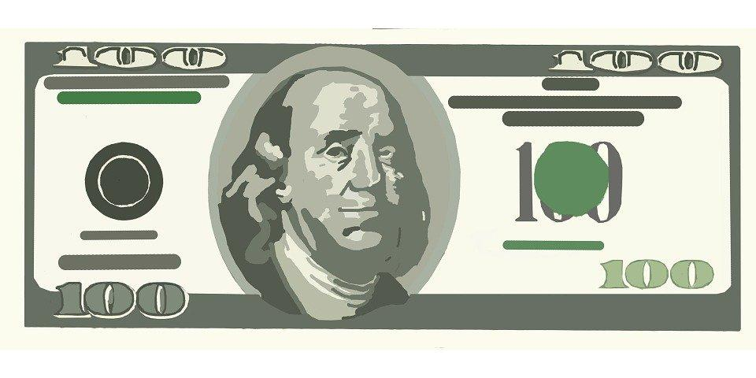
Gifts from the wallet
Notes:
Cash
IRA Qualified Charitable Distribution
Charitable Gift Annuity
A way to upgrade annual donors - get an indication of affinity and ability - and open the door to a conversation
$300 / $600 for couples - deduction for cash gift for every taxpayer - even non-itemizers!
CARES Act: increases the 60% limit for cash donations during 2021 to 100% for cash gifts to charities that are not donor advised funds or supporting organizations.

Slide 6
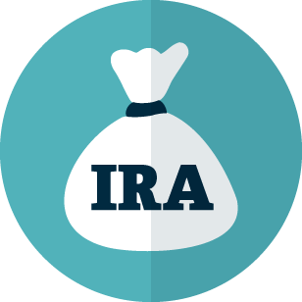
IRA Qualified Distribution
Donor must be 70½ years old
Up to $100,000 each year
Amount counts toward
Required Minimum Distribution
No charitable deduction
No income tax
Notes:
Make a Qualified Charitable Distribution (QCD) of IRA assets
Whether itemizing or claiming the standard deduction, individuals age 70½ and older can direct up to $100,000 per year tax-free from their Individual Retirement Accounts (IRAs) to operating charities through QCDs (no DAFs or private foundations). By reducing the IRA balance, a QCD may also reduce the donor's taxable income in future years, lower the donor's taxable estate, and limit the IRA beneficiaries' tax liability.

Slide 7
A gift that pays income for life
Charitable gift annuity
Donor makes a gift.
Receives a tax deduction and guaranteed income payments for life.
The gift is invested and managed.
After the donor’s lifetime, the charity receives the amount that remains.
Notes:
If you are age 55 or older, you can help secure your retirement with a charitable gift annuity. In exchange for your gift of cash or stock, you receive fixed payments for Life at attractive rates, while securing a partial tax-deduction, if you itemize. It's also a wonderful way to provide for loved ones.
If you use appreciated securities, also saves capital gains tax.
Some of the payments you receive are tax-free.
Rates vary based on age, but as an example:
70 years old: 4.7%
Couple, both 73 years old: 4.4%
Can also establish now and defer the start of payments to a future date.
Flexible, easy, guaranteed income AND charitable impact.

Slide 8
During Life
and/or ...
Later
Notes:
transferred outside of one’s will to heirs/charitable interests.
Appreciated securities and other appreciated assets
Retirement Accounts
Beneficiary designation (retirement accounts, life insurance)

Slide 9
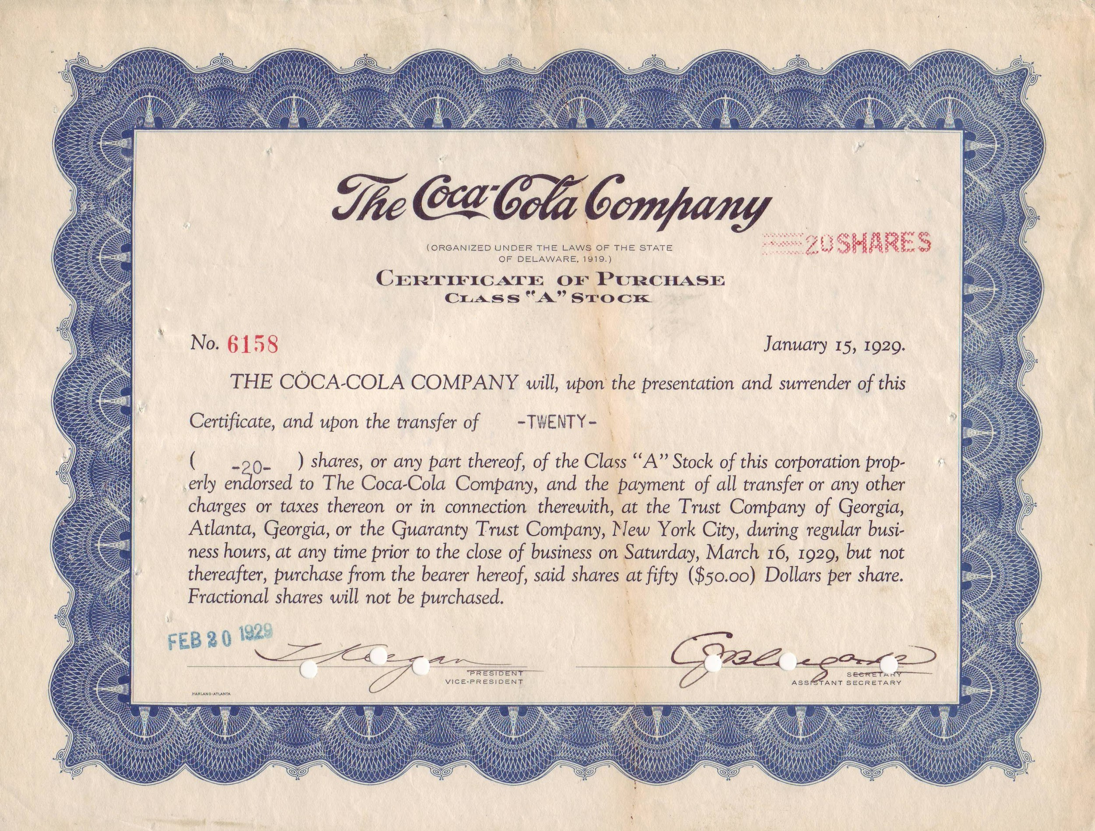
Gifts from investments
Notes:
Give appreciated stock or mutual fund shares, avoid capital gains taxes
Make a Qualified Charitable Distribution (QCD) of IRA assets
Whether itemizing or claiming the standard deduction, individuals age 70½ and older can direct up to $100,000 per year tax-free from their Individual Retirement Accounts (IRAs) to operating charities through QCDs (no DAFs or private foundations). By reducing the IRA balance, a QCD may also reduce the donor's taxable income in future years, lower the donor's taxable estate, and limit the IRA beneficiaries' tax liability.
IRA revaluations at end of year determine next year’s QCD - folks may be getting surprised by how much they have to withdraw
Use a charitable deduction to help offset the tax liability of a retirement account withdrawal Those over age 59½ (to avoid an early withdrawal penalty) who take withdrawals from retirement plan accounts in 2020 may use deductions for their charitable donations to help offset income tax liability on the withdrawals.

Slide 10
Gifts of other assets
Notes:
What do you own? Is it valuable (and how do you know)? Has the value appreciated? Do your kids want it? Do you owe anything on it? Are you thinking about selling it?
Wouldn’t it be great to just straight up ask the questions that will help you identify assets that might be ripe for charitable giving?
Real estate - house or vacation property, rental property
Business interest - how is it structured? Don’t have to give it all - most gifts are for a partial interest
Virtual currency
Art or collectibles - related use rule can make this more complicated to assess, but often still attractive, especially it the “thing” has carrying costs, like insurance, storage, etc.

Slide 11
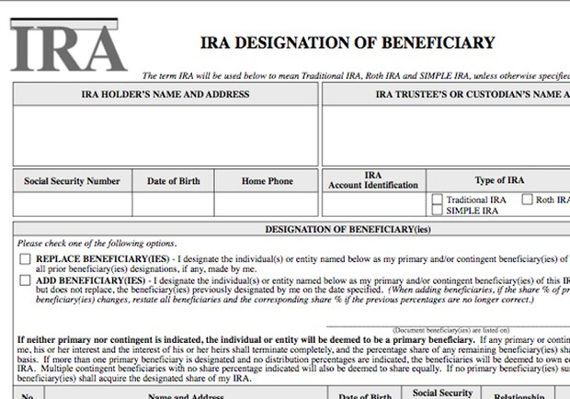
Notes:
Are the beneficiary designations on my retirement plans or IRA accounts and insurance policies are aligned with my current plans?

Slide 12
Later
also known as ...
at Death

Slide 13
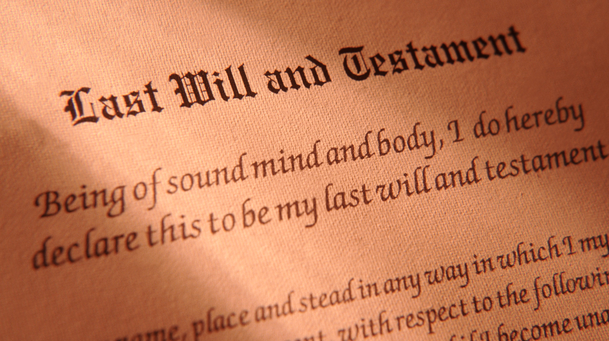
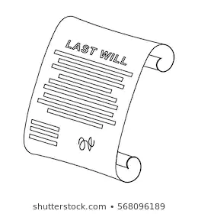
Notes:
Encourage will-making
Encourage charity in wills
Identify a value: Organization’s Legacy Society members want everyone in our community to have a safe home.
Associate status with that value - “Join today”
Create “experienced gift value” today (remember the brain chemistry?)
Come from a place of being helpful.
Everyone should have a will. So a good place to begin with your marketing is simply to offer helpful content (e.g., on your website, in your e-newsletter or on your blog) about why people need wills. To take care of their loved ones. To make administering their estate less of a burden for family or friends. To assure their hard-earned assets are directed where they most wish them to go – because you can’t take it with you! You can’t write their wills for them; that would be a conflict of interest. But you can provide simple language they can share with their advisors for leaving a bequest to your charity (here’s an example from Alex’s Lemonade Stand). They may not use this information right away, and they may or may not notify you if they do this, but at least you’ve planted the seed. And from little seeds, big plants sometimes grow.
You might be surprised how many donors with heirs will still leave a charitable bequest. I’ve worked with plenty of wealthy philanthropists who don’t want to leave too much to their children, because they want them to become confident, productive, contributing members of society. If someone has a $50 million estate, for example, they may leave $15 million to each of their two kids and $20 million to charity. I’ve also worked with less wealthy donors who still want to leave a legacy to a beloved charity they’ve supported throughout their lifetimes. “My kids won’t miss an extra $10,000 when I die, and this is something I’d like to do – both to communicate my ethics to my heirs and to leave the community improved by my philanthropy.”
Here are some simple bequest marketing strategies:
On your website: “Where there’s a will there’s a way. Learn how a will can help you accomplish personal family, financial and charitable objectives.”
On your donation landing page:“What will your legacy be?” “Consider leaving a legacy to memorialize your important values.” Then include suggested language.
On your outer mailing envelopes or email signature:“Please remember XYZ charity in your will.”
Ask donors if they’ve made provision for your charity in their estate plans. Do this:
On your mailed appeal donor remit pieces
On your online donation landing page
In a mailed or emailed survey
As an insert to another publication (e.g., annual report; program brochure; volunteer application)
Ask donors if they’d like more information about leaving a bequest.
Send a targeted mailing. If you’ve done some predictive modeling around “planned giving likelihood” you may have a good idea who your best prospects are, so save more expensive targeted legacy campaigns for them (or for folks who’ve given frequently and are clearly loyal).

Slide 15
Notes:
Real estate - house or vacation property, rental property
Business interest - how is it structured? Don’t have to give it all - most gifts are for a partial interest
Virtual currency -
Art or collectibles - related use rule can make this more complicated to assess, but often still attractive, especially it the “thing” has carrying costs, like insurance, storage, etc.

Slide 16
Stewardship
Notes:
People like to belong to groups of like-minded folks who share their values. Human beings are joiners. The like being part of a ‘club’– even if it only means you recognize them on a donor honor roll, send them a certificate or share a special newsletter with them. So do what you can to show legacy donors are much you honor them.
Ongoing cultivation and stewardship is important for all donors if you want to retain them. But it’s true in spades for legacy donors. Because these gifts are often revocable. If you’re out of sight with these folks you risk being out of mind the next time they visit their attorney. Or perhaps another charity will actively ask them to name them as a retirement or insurance plan beneficiary. This is easy enough for them to change, so why wouldn’t they if they’ll get more high fives and pats on the back from someone else?
Here are some simple legacy recognition society strategies:
Publicly recognize members (with permission) wherever you have donor honor rolls (e.g., annual report; newsletter; programs; website).
Host an annual recognition event (virtual or in-person) to reinforce donor commitment. This is an opportunity to have donors share their personal stories as to why they made this gift, which works to inspire others to sustain or even increase their own giving.
Offer periodic informational events (e.g., town halls, brown bags; fireside chats) to keep donors apprised of the latest goings-on and focused on the values you and they are enacting together.
Publish a legacy society newsletter or blog.

Slide 17
Bonus idea
Donor advised fund
Then what?
Notes:
What happens to the assets after the donor’s lifetime?

Slide 18
Questions?
Sheryl Aikman
Principal, Alenda Consulting
alendaconsulting@gmail.com

